Slide 2
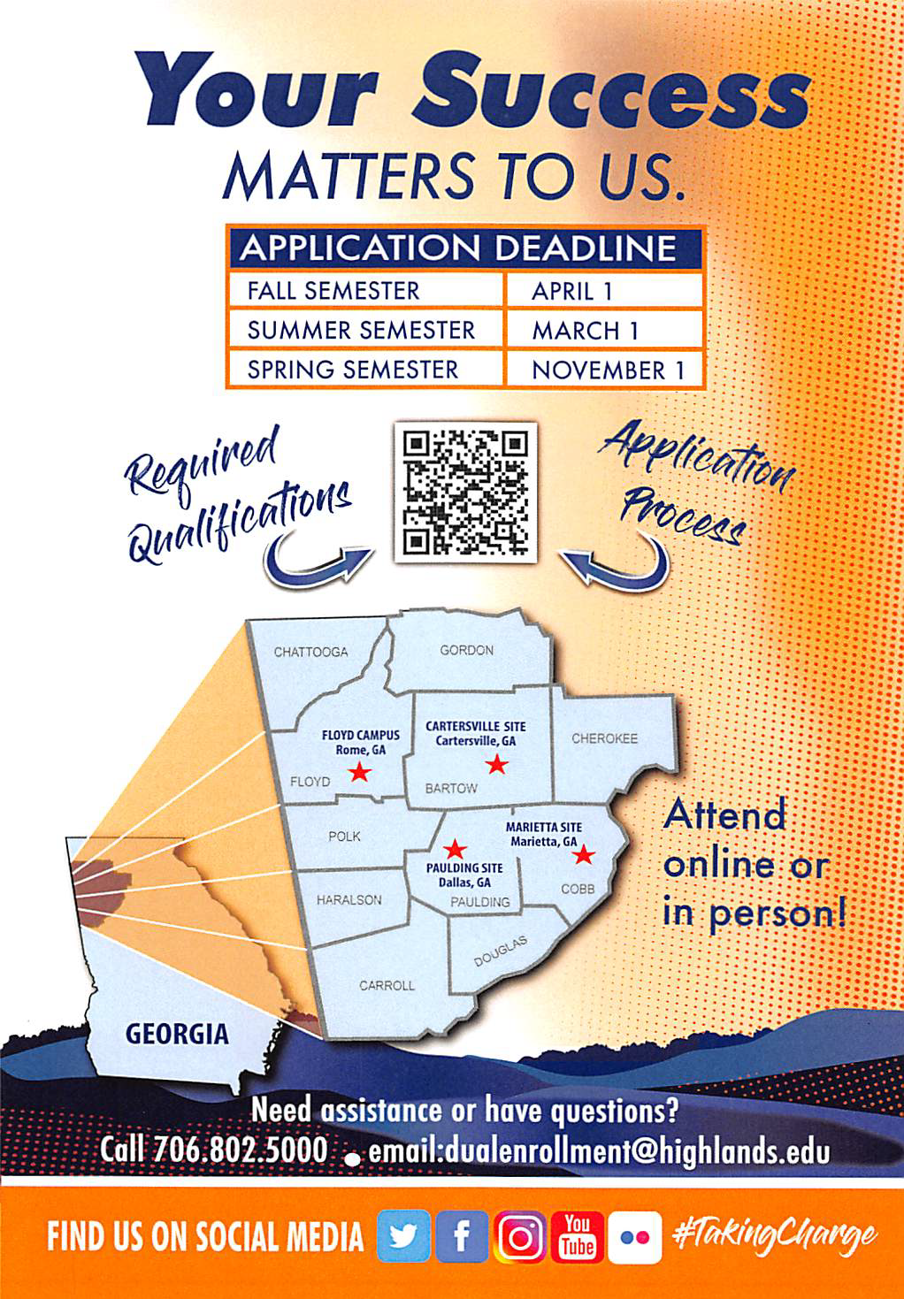

Slide 3
About Georgia Highlands College
State, public college opened in 1970 as Floyd Junior College in Floyd Co.
A member institution of the University System of GA (USG)
Course transferability through-out the 26 USG “sister institutions
Locations
Rome
Cartersville
Marietta
Dallas

Slide 4
Current GHC DE Admission Guidelines:
10th, 11th & 12th Grades Admissions Requirements

Slide 5
Admissions Application Process:
Create a GAfutures account if you do not have one. You will use your GAfutures account for both your admission application and funding application.
Complete the GHC Admissions Application by the required deadline.
Testing:
If you have qualifying PreACT, ACT, PSAT or SAT scores, request that they be sent to GHC directly from the testing authority.
PSAT and PreACT scores are currently approved for 2022/2023 & 2023/2024.
OR you may register for the Accuplacer test through your GHC Check Admissions Status page.
Note: The deadline does not apply to testing and/or test score submission.
Have your high school transcript sent to GHC.
Be on track to complete Required High School Curriculum as set forth by the USG.
Have any previous DE college attendance transcripts sent to GHC
*All of the above are required before an admission decision can be made.
Students must be admitted before they can be registered for class.
Please seek approval from high school counselor before beginning the admissions process.

Slide 6
Admissions Application Process Con’t:
Once the requirements one the previous slide have been received and processed, your file will be reviewed for an admission decision. The decision will be shown on your Check Admission status page, you will receive an email advising of your acceptance as well as an admission packet in the mail.
After being admitted, complete the pre-orientation on your Check Admission
Status page and then register for the on-campus in-person orientation.

Slide 7
Admissions Application Process Con’t:
Can be done in any order:
Have any AP score reports sent to GHC.
Submit Lawful Presence.
Student and parent/guardian complete the online GSFC DE Funding application.
You might find this video tutorial helpful.
Submit your GHC Certificate of Immunization or GRITS . Additional information on following pages.
Complete the FERPA release if you would like us to be able to speak with your parent/ guardian and submit it to registrar@highlands.edu. Additional information following.
Monitor your Check Admissions Status page for outstanding requirements, holds, and your current admission status.
There is nothing you need to do for the Joint Enrolled hold.
When it is time to register for classes, I will send directions on how to review the course offerings page and submit the DE Course Request Form.

Slide 8
Class Eligibility Based on Test Scores
Class Placement:
The test scores used for admission, will determine what classes a DE students will be eligible to take.
Your high school counselor and myself will help in advising of class eligibility.
If you find you are not currently eligible to take certain classes you wanted to, you may submit new scores if you retest and have a higher score.
Students who meet the minimum math admissions score are eligible to take MATH 1001 or STAT 1401, as long as they have had high school Algebra II/Advanced Algebra (or an equivalent course).
To be eligible to take MATH 1111, in addition to having completed high school Algebra II/Advanced Algebra (or an equivalent course), the student must also meet learning support exemption scores, which are set higher than the admission score requirements:
SAT - Math Section score of 510
ACT - Math score of 20
ACCUPLACER Quantitative Reasoning, Algebra, & Statistics - of 266
In order to take ENGL 1101, the following scores are needed:
SAT – EBRW 480
ACT – Reading 17 or English 17
Accuplacer – WritePlacer 4 & Reading 237

Slide 9
Funding:
Funding:
10th grade students must meet Georgia Student Finance Commission requirements to be eligible for funding:
ACT Composite score of 26 or
SAT Total of 1200
Self-Pay:
10th grade students who meet admissions requirements but not funding requirements will be responsible for paying tuition/fees and purchasing any required course books/codes/materials out-of-pocket.
Any grade level student who is eligible for funding but take unfunded classes or exceed the 30-hour max will be responsible for paying tuition/fees and purchasing any required course books/codes/materials out-of-pocket.
The electronic DE Self-Pay Form will need to be completed by the student, parent/guardian, and high school counselor/DE Coordinator before the student will be registered for class(es). Once it is determined a student is self-pay, I will start the form and it will be routed via email for completion/signatures.
Students who fall within the self-pay category should contact the DE Coordinator to
discuss the rate as several variables factor into the equation.

Slide 10
QUESTIONS?
Contact Info:
Mary Ann Sailors
Dual Enrollment Coordinator
dualenroll@highlands.edu
706-368-7744

