Slide 1
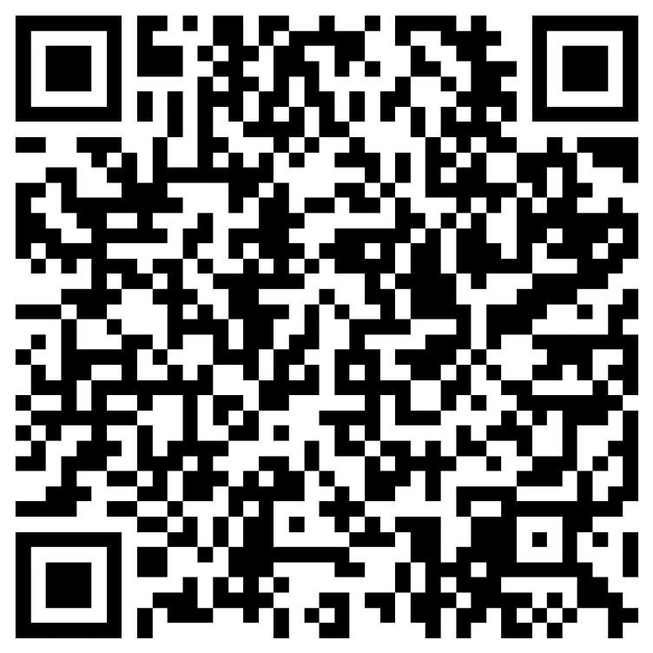

Slide 2
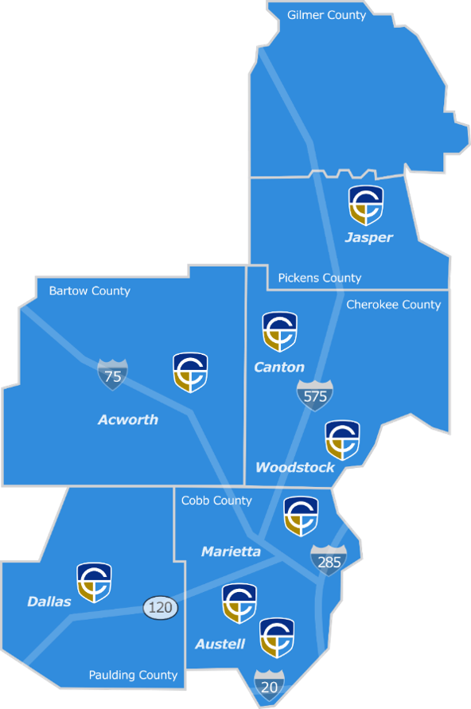
Campus Locations
Core classes are offered at 7 of our campus locations!
Appalachian Campus
Austell Campus*
Canton Campus
Marietta Campus
Mountain View Campus
North Metro Campus
Paulding Campus
Woodstock Campus
70-plus degrees, diplomas, and certificates in more than 50 programs of study.
*Corporate Training

Slide 3
Student Services
*Academic Advisement
*Academic Success Center
-Free Tutoring
*Career Development
-Career Exploration
-Resume Writing Workshops
-Interview Preparation
*Counseling
-Free to all Chatt Tech students
*Access to the Chatt Tech Library & Bookstore
*Textbook Lending Program
*Disability Support Services
-Free services and advocacy to students with disabilities
*Veteran Services
*Golden Eagle Food Pantry

Slide 4
PROGRAM OFFERINGS
Chatt Tech offers courses during the day, evening, and weekend classes; both online and in-person.
Certificates I Diplomas I Associate Degrees

Slide 5
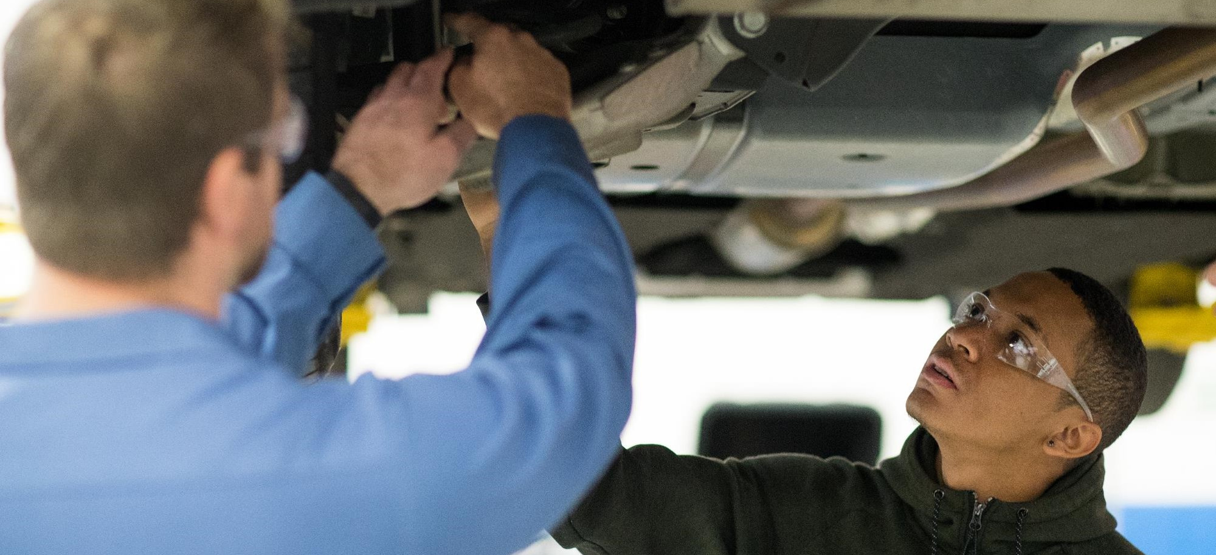
Certificates
•Prepare students to meet specific skills/ training in the workforce
•8 weeks to 1 year to complete
•Options after completion: Diploma, Associate Degree, or Workforce

Slide 6
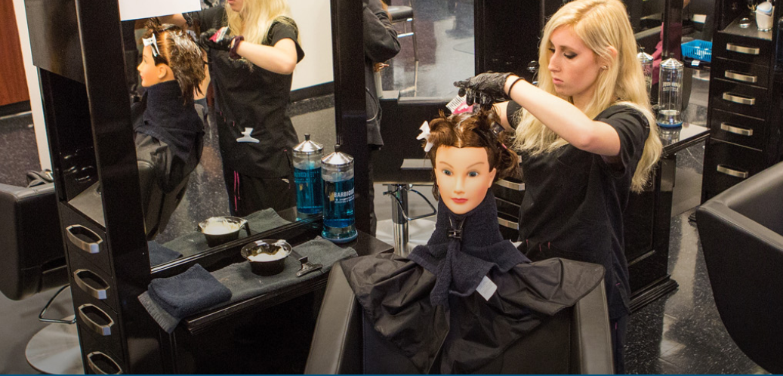
Diplomas
•Trains and educates students for a career that needs a specific set of specialized job skills
•1 year to 1.5 years to complete
•Options after completion: Associate Degree or Workforce

Slide 7
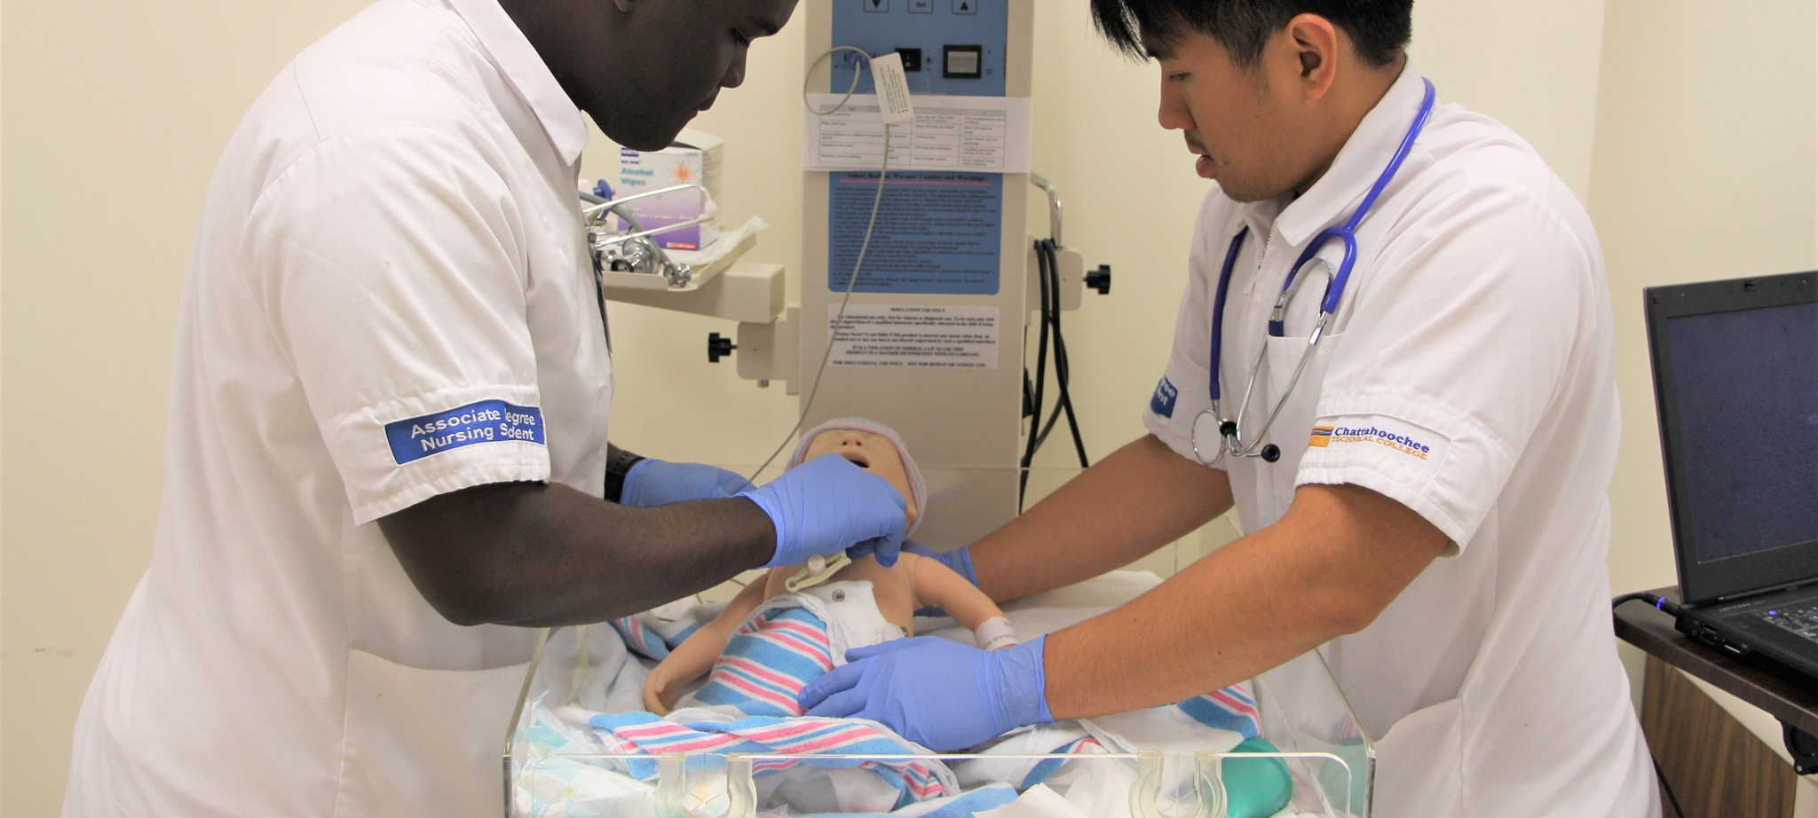
Associate Degrees
•A two-year post-secondary degree
•2 year to 2.5 years to complete
•Options after completion: Workforce or Bachelor's Degree

Slide 8
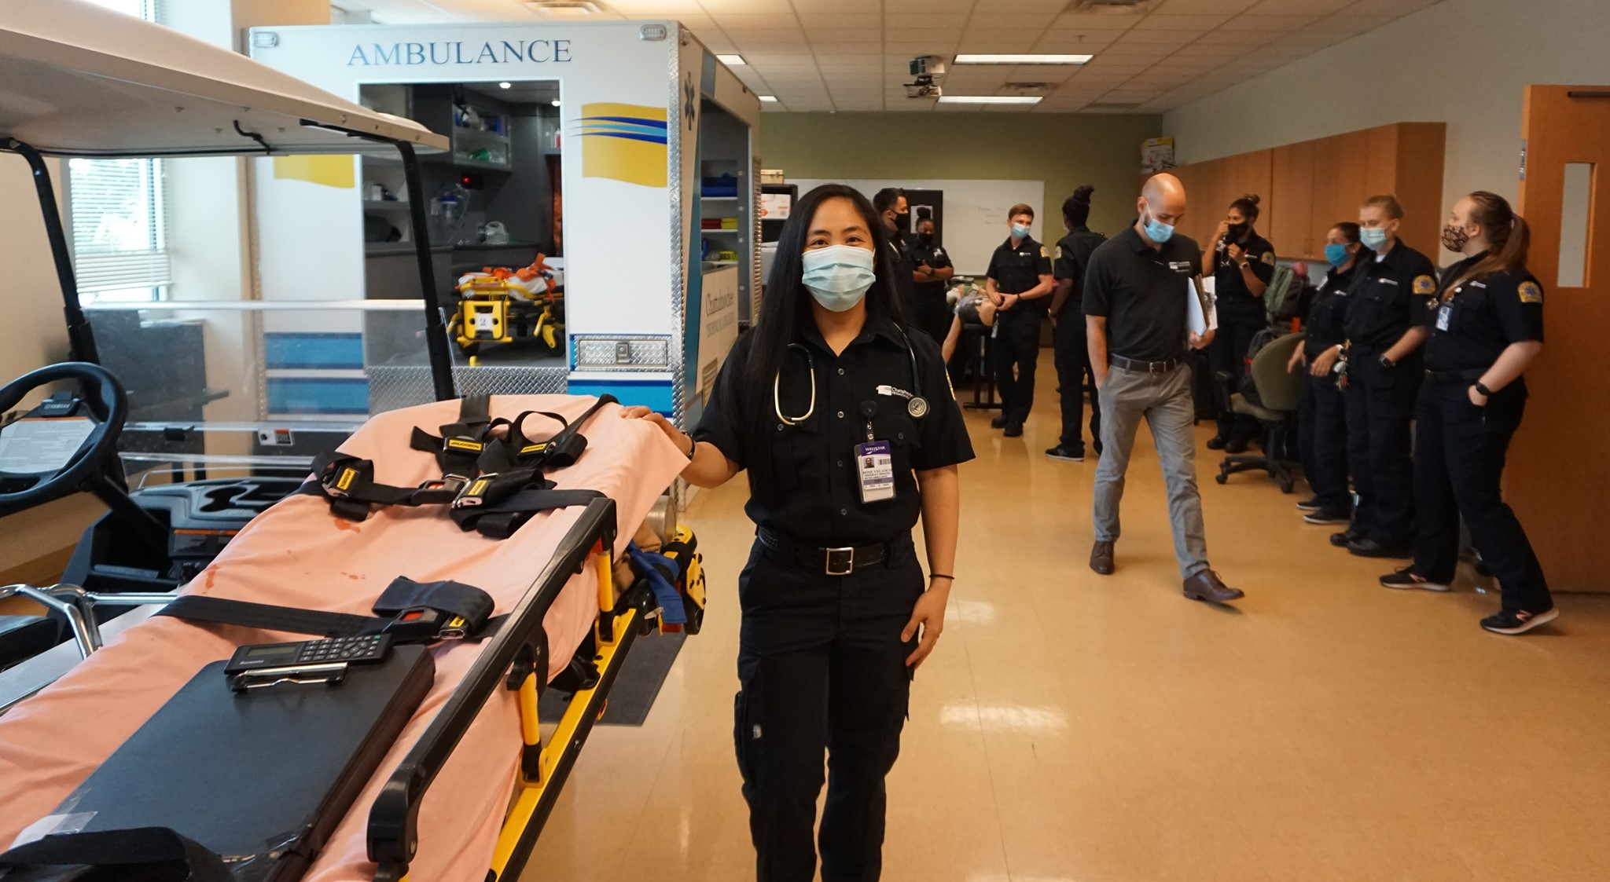
Health Sciences
#1 Practical Nursing Program in GA
#1 Nursing Program in GA
Associate of Science in Nursing
Clinical Laboratory Technology
EMT/ AEMT
Dental Assisting
Health Care Management
Medical Administrative Assistant
Medical Assisting
Nursing Assistant (CNA)
Occupational Therapy Assistant
Paramedicine
Patient Care Technician (PCT)
Physical Therapist Assistant
Practical Nursing
Radiography
Surgical Technology

Slide 9
Business
Programs of Study
Accounting
Business Management
Business Technology
Logistics & Supply Chain Management
Marketing Management

Slide 10
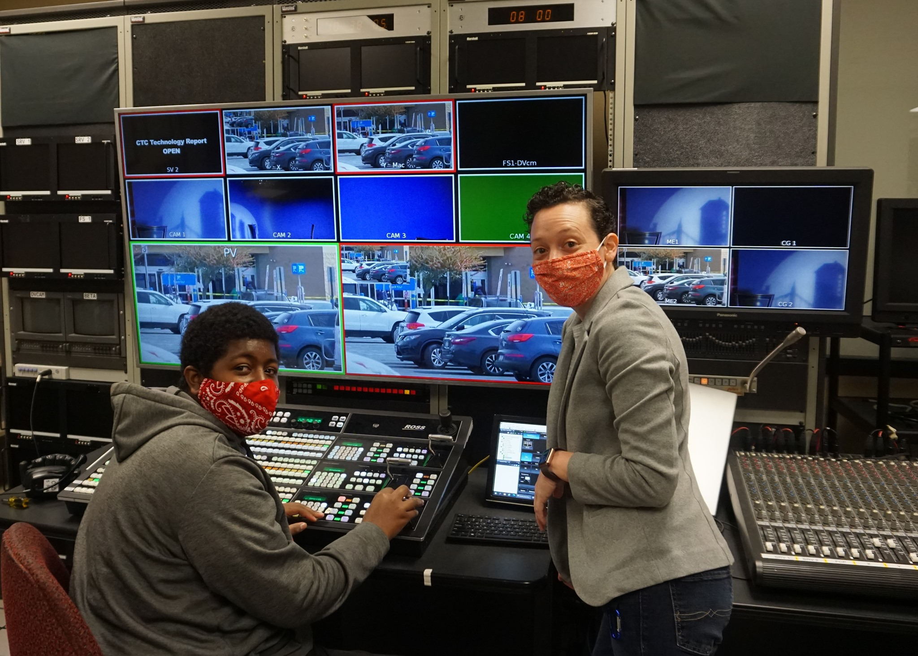
Technical Studies
Computer and Digital Technologies
Computer Information Systems
Computer Programming
Cybersecurity
Networking
Web Application Development
Cisco Network Specialist Certificate
CompTIA A+ Certified Technical Prep Certificate
Digital Media Technologies
Design and Media Production Technology
Film & Television Production Technology

Slide 11
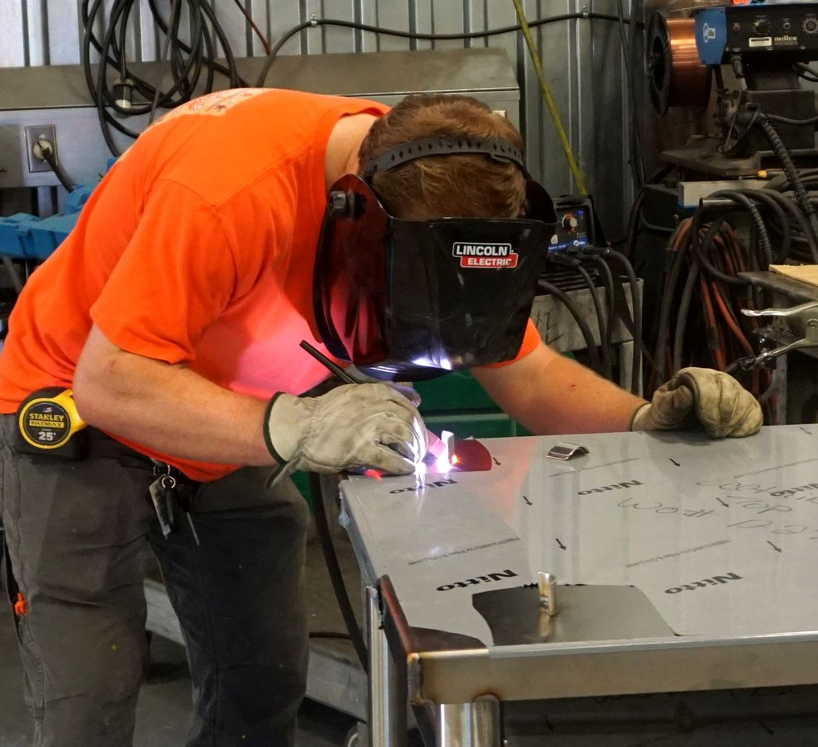
Technical Studies
Building, Manufacturing, & Engineering
Air Conditioning Technology
Applied Technical Management
Carpentry
Drafting Technology
Electrical and Computer Engineering Technology
Environmental Technology
Industrial Maintenance and Electrical Technology
Precision Machining and Manufacturing
Welding & Joining Technology
Transportation
Automotive Collision Repair
Automotive Technology
Commercial Truck Driving
Diesel Equipment Technology

Slide 12
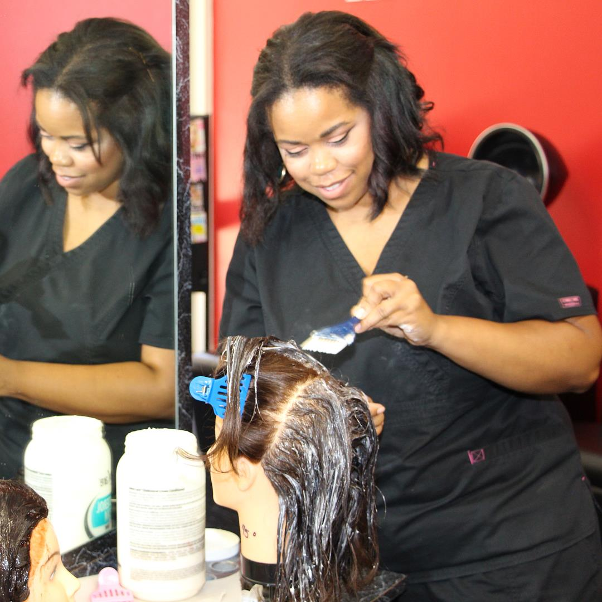
Technical Studies
Public and Professional Services
Cosmetology
Criminal Justice Technology
Culinary Arts
Early Childhood Care & Education
Horticulture
Interiors

Slide 13
Transfer Credit
Under the Complete College Georgia Agreement, University System of Georgia institutions
and Technical College System of Georgia institutions will accept the following
general education courses for transfer between their respective institutions:
Economics (Macro
Economics (Micro)
Economics (Principles)
English Composition I
English Composition II
Humanities (Intro)
Math Modeling (Intro)
Pre-Calculus
Physics Introduction I
Physics Introduction II
American Government
American Literature
Art Appreciation
Biology Introduction I
Biology Introduction II
Calculus
Chemistry I
Chemistry II
College Algebra
Psychology (Intro)
Public Speaking
Quantitative Reasoning
Sociology (Intro)
Statistics (Intro)
US History I
US History II
World History I
World History II

Slide 14
Arts & Sciences
Programs of Study
Associate of Applied Science
Degree in Interdisciplinary Studies
- Allows students to customize their
program based on their own
academic and professional goals.
Technical Specialist Certificate
- Prepares students for professional
opportunities requiring effective
communication skills in addition to
proficiency in technical areas.

Slide 15
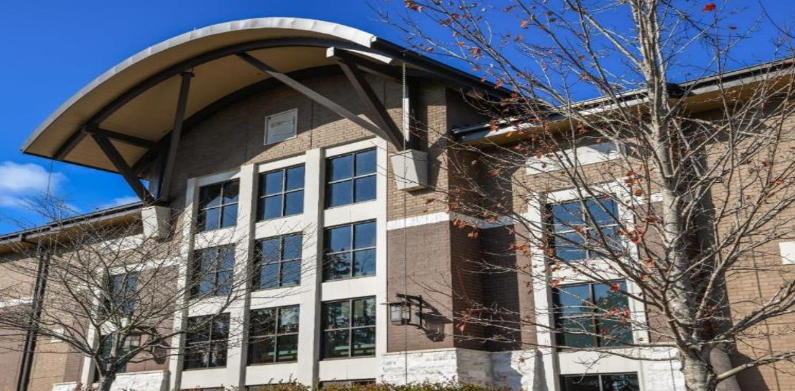
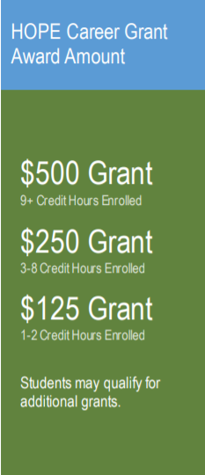
After 30 Hours of DE Funding is used...
HOPE Grant/HOPE Career Grant program
-Students wishing to use the HOPE Grant/HOPE Career Grant must choose from a HOPE Career Grant programs at CTC.
-Students who use the HOPE Grant/HOPE Career Grant must meet HOPE
residency requirements.
-Students are responsible for paying tuition, required fees, and textbook/access code costs, and any costs not covered by the HOPE Grant/HOPE Career Grant.
-Any HOPE Career Grant or HOPE Grant hours used will count against HOPE and Zell Miller Scholarships cap.
Self-Pay
10–12th graders who are not eligible for dual enrollment funding or HOPE Grant/HOPE Career Grant can cover their Dual Enrollment courses by choosing to pay for their classes.
They will be responsible for all tuition, fees, and textbook/access code costs.

Slide 16
DE Admission Steps
Submit a free online DE admissions application on Chatt Tech's Website.
Complete the DE Advisement Plan with your high school counselor.
Complete the DE Student Participation Agreement/ Funding Application on gafutures.org.

Slide 17
DE Admission Steps
Parent/Guardian must electronically complete the Parent Participation Agreement on gafutures.org.
Parents/Guardian must complete the DE Funding Acknowledgement form on the Chatt Tech website.
Submit Verification of Lawful Presence.
(birth certificate, drivers license, permit, U.S. passport)

Slide 18
Spring 2023 (January – May 2022)
November 1, 2022 - DE College Admission Application deadline
November 15, 2021 - DE document deadline
Summer 2023 (June-July 2022)
March 1, 2023 - DE College Admission Application deadline
March 15, 2022 - DE document deadline
Fall 2023 (August -December 2022)
May 1, 2023 - DE College Admission Application deadline
May 15, 2022—DE document deadline
Application & Document Deadlines

Slide 19
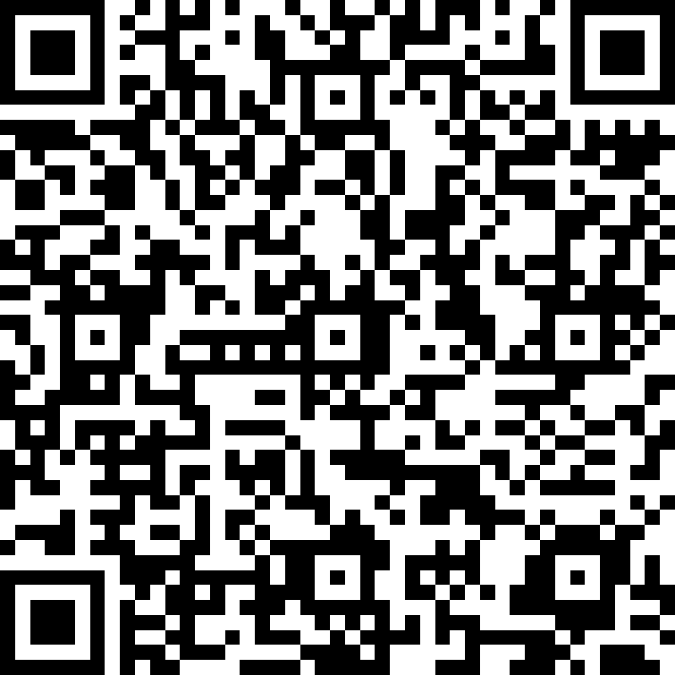
Questions?
@chatttechde

