Slide 1
Motion Graphs

Slide 2
Position Vs. Time Graphs
To Find distance from starting point:
Look at # on Vertical Axis
To determine how fast (speed/velocity of object)
Determine the steepness (slope) of the graph
To determine which direction object is moving
Look at which way the graph is sloped
The line is moving up = moving forward
The line is moving down = moving backwards
Lines = constant speed
Curves = acceleration

Slide 3
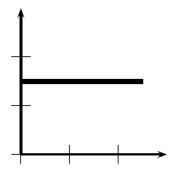
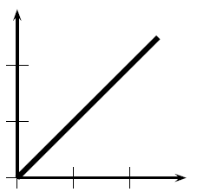
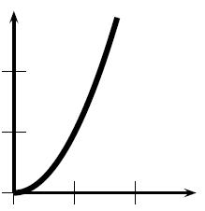
Position Vs. Time Graphs
P
P
P
P
time
time
time
Object is at rest
Object is at a constant (+) velocity (moving forward)
Object is accelerating (+ acceleration)

Slide 4
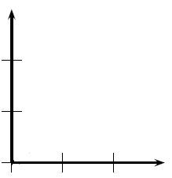
Position Vs. Time Graphs
D. Constant (-) velocity (moving backwards)
E. Object is accelerating (speeding up backwards)

Slide 5
Position Vs. Time Graphs
What else does the graph tell us?
The slope is the velocity
Steep slope = higher velocity
Shallow slope = lower velocity
To find instantaneous velocity of curve= tangent line

Slide 6
Velocity Vs. Time Graphs
To find how fast it is moving:
Look at # on Vertical Axis
To determine which direction object is moving
Look at whether it is above or below x-axis (0 m/s)
Above the x-axis = moving forward
Below the x-axis = moving backwards
To determine how far the object has moved
Determine the area between the line and x-axis
It is impossible to tell exact position. (only how far moved)
Horizontal line = constant speed
Diagonal line or curve = acceleration (+ or - )

Slide 7
Velocity Vs. Time Graphs
P
v
v
v
time
time
time
Object is at constant velocity (moving forward)
Object is undergoing uniform (+) acceleration
Object is accelerating (non-uniform)

Slide 8
Velocity Vs. Time Graphs
D. Object is undergoing a uniform (-) acceleration
Object has a non-uniform (-) acceleration
What would it mean if something was under the x-axis?

Slide 9
Velocity Vs. Time Graphs
What else does the graph tell us?
The slope is the acceleration
Steep slope = higher acceleration
Shallow slope = lower acceleration
Any line above the x-axis is moving forward
Any line below the x-axis is moving backwards

Slide 10
Acceleration Vs. Time Graphs
P
A
A
time
time
Object is accelerating at a constant rate
Object is accelerating at an increasing rate
The object is getting faster at a faster rate

Slide 11
AccelEration Vs. Time Graphs
A
A
time
time
C. Object is accelerating at a decreasing rate
the object is getting faster….slower
D. Object has a negative acceleration

Slide 12
Acceleration Vs. Time Graphs
What else does the graph tell us?
The slope is meaningless
The area underneath the line is the velocity.

Slide 13
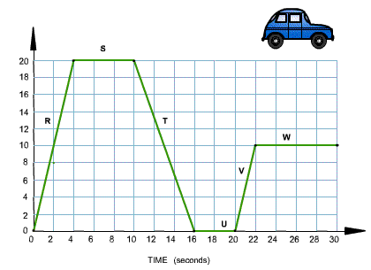
Practice Graph

