Slide 1
Learning Target: Explain how natural selection affects the evolution of species on earth?
Standards:
S7L5a. Explain that physical characteristics of organisms have changed over successive generations (e.g. Darwin’s finches and peppered moths of Manchester).
S7L5b. Describe ways in which species on earth have evolved due to natural selection.
Notes:
Instructional strategy - The teacher should review the essential question and the standards that align to the essential question

Slide 2
What is evolution?
Evolution is the process through which species change over time.
Turn to a partner and discuss some of the evidence that supports the theory of evolution.
Notes:
Instructional strategy – Present information on the slide. Have students copy the definition of evolution onto their notes sheet. With an elbow partner, have the students review supporting evidence. NOTE: Darwin’s Finches are specifically mentioned in the standard. Other resources than those mentioned in the following slides are linked in the content map.

Slide 3
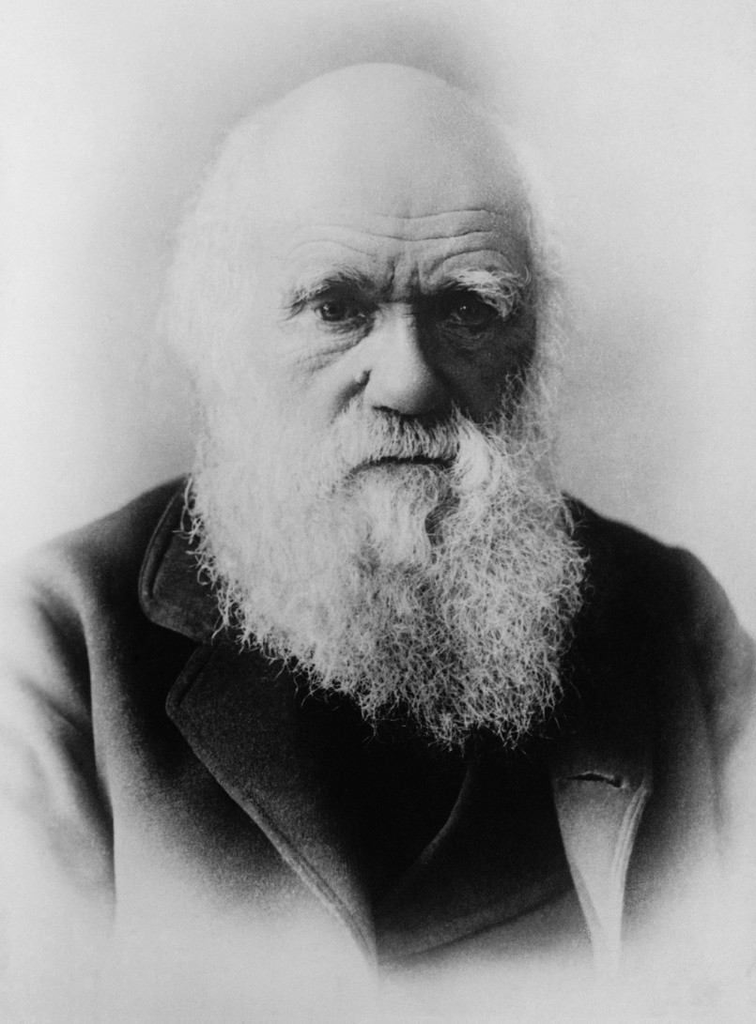
The basis for the theory of evolution came from observations by Charles Darwin.
Notes:
Instructional strategy – Present information in the slide. Have students use the information to fill in the first part of #2 on the notes sheet.

Slide 4
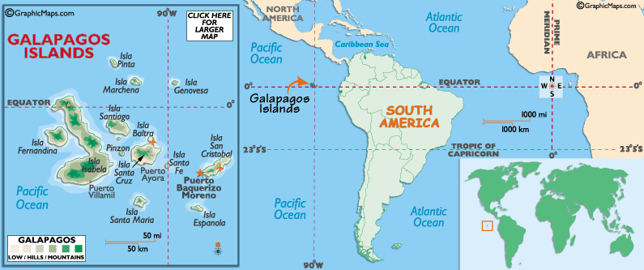
Darwin’s observations were made when he visited the Galapagos Islands, a chain of volcanic islands off the South American coast.
Notes:
Instructional strategy – Present information on the slide. Have students use the information to finish #2 on their notes sheet.

Slide 5
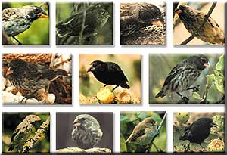
Darwin observed many similar-looking birds with very different beaks. But how since they are were on an island?
Notes:
Instructional strategy – Allow students to hypothesize how the differences ocurred. Note: Darwin’s finches are specifically mentioned in the standards.

Slide 6
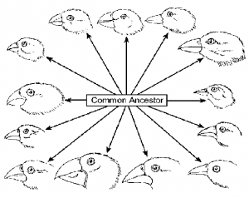
Darwin’s observations made him wonder if the finches had evolved from similar species.
Notes:
Instructional strategy –Review common ancestors. Have a brief discussion on the similarities of the finches

Slide 7
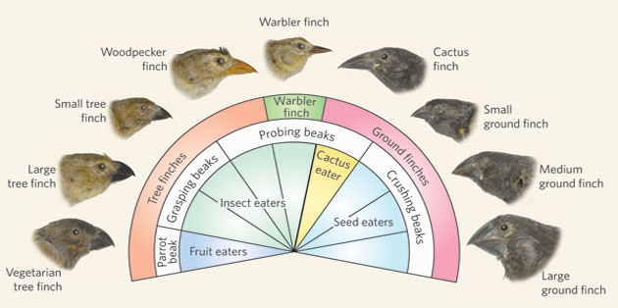
After years of analyzing his observations, Darwin proposed that the birds were closely related finch species that were suited to different environments.
Notes:
Instructional strategy – Present information in the slide. Students will use the information to fill in #4 on their notes sheet.

Slide 8
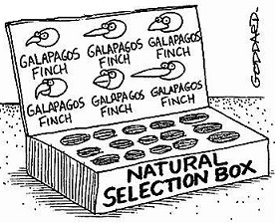
Darwin proposed that evolution could be explained through a process he called natural selection.
Notes:
Instructional strategy – Present information in the slide. Students will use the information to fill in the first part of #5 on their notes sheet. (The process will be explained in upcoming slides)

Slide 9
Natural Selection
A process through which species that are best suited to their environment survive and reproduce at a higher rate than other members of the species.
Notes:
Instructional strategy – Present the information on the slide. The students will use the information to fill in the second part of #5.

Slide 10
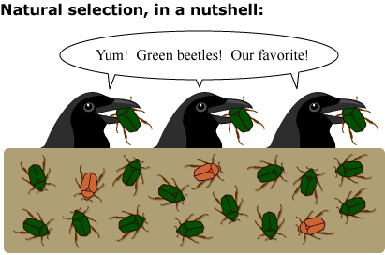
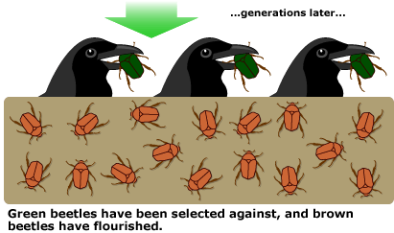
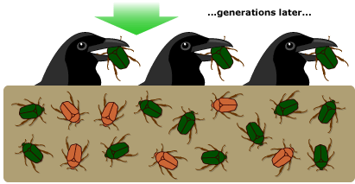
Notes:
Instructional strategy – This is a series of slides. Have students hypothesize what made the brown beetle population increase whereas the green beetle population decreased. (Possible answers: camoflage, bad taste to birds) “Breeding Bunnies” (linked in the content map) may be used here.

Slide 11
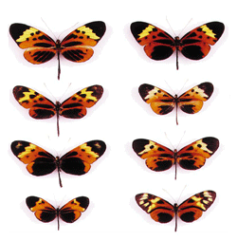
One of the key ideas of natural selection is variation among species.
Notes:
Instructional strategy – Present the information in the slide. Students will use the information to fill in #7 on their notes sheet.

Slide 12
Within a species there are natural differences, or variations, in traits.
Look at the images of the butterflies above. What causes these variations?
Notes:
Instructional strategy – Present information in the slide. Have students hypothesize what causes the variations.

Slide 13
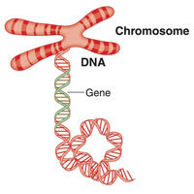
Many of the differences among individuals results from differences in the genetic material of organisms.
Notes:
Instructional strategy – Present information in the slide. Students will use the information to fill in the first part of #8 on their notes sheet.

Slide 14
Which organisms can have a greater variation in genetic material? Why?
Those who reproduce sexually have greater variation in genetic material because the organism receives genetic material from both parents.
Notes:
Instructional strategy – Present information in the slide. Students will use the information to answer the last part of #8 on their notes sheet.

Slide 15
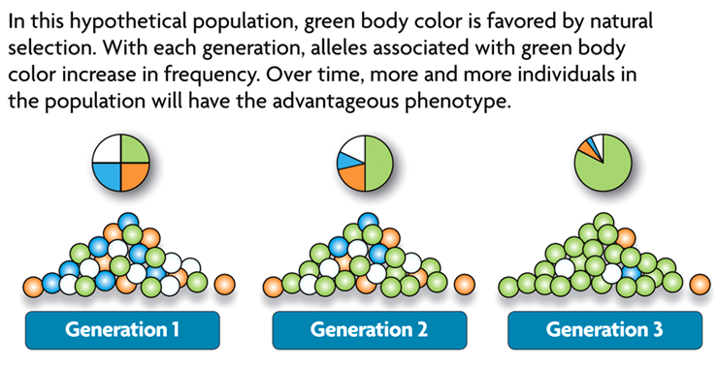
Natural Selection and Genetic Variation
Successive Generations
Notes:
Instructional strategy – Present material in the slide. Have students use this slide to finish the second part of #8.

Slide 16
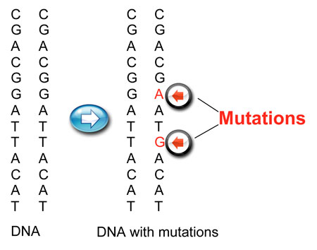
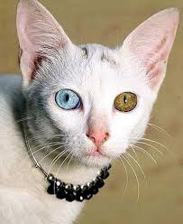
Sometimes the genetic material itself within organisms changes, causing a new variation (mutation).
Notes:
Instructional strategy – Students do not have to know ACT&G, but should be able to note a difference in the sequencing between the original and the mutation. Students will use this information to answer #9 in their notes sheet.

Slide 17
Notes:
Transition slide

Slide 18
What serious illness currently in the news has underwent a mutation? How has it affected us?
The Flu. The Flu shot is not as effective this year because the flu virus mutated; therefore, the vaccine does not cover all strands of the virus.
Notes:
Instructional strategy – Remind student of the flu outbreak during the last year, and how the flu shots did not prevent the flu like it was supposed to. The flu mutated, therefore making it resistant to the vaccine.

Slide 19
Sometimes the environment contributes to genetic variation such as the diagram to the right shows.
Notes:
Instructional strategy – Present information in the slide. Follow illustration to show how the river influences genetic variation. Students will use information to fill in #10 on their notes sheet.

Slide 20
An adaptation is any inherited trait that gives an organism an advantage in its particular environment.
Notes:
Instructional Strategy – Present information on the slide. Students will use this to fill in #11 on their notes sheet. Take 3-4 minutes to have students share their examples.

Slide 21
Notes:
Instructional Strategy - present information on the slide, noting that each adaptation helped the animal survive.

Slide 22
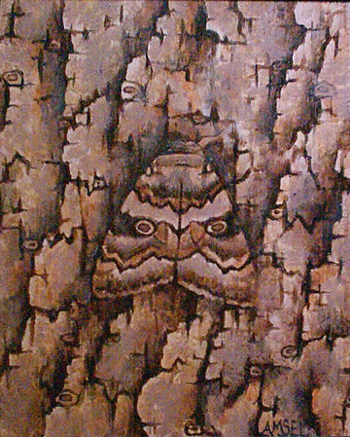
Camouflage
Camouflage is a type of adaptation in which organisms appear to “blend” into their environment.
Notes:
Instructional Strategy – Present information in slide. Students will use the information to fill in #12 on their notes sheet. Ask students to give other examples of camoflage.

Slide 23
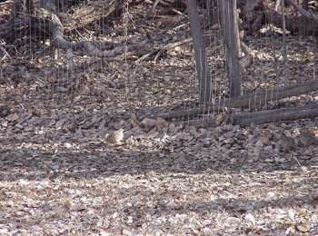
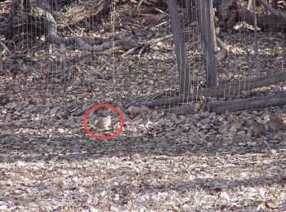
Where Am I?
Notes:
Instructional Strategy – Slide is in two parts. Allow a little bit of time (if needed) for students to find the organism. Click to bring up the red overlay.

Slide 24
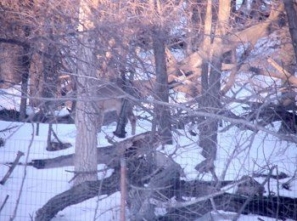
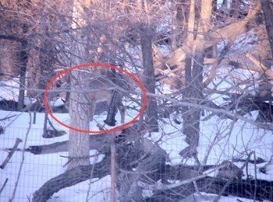
Where Am I?
Notes:
Instructional Strategy – Slide is in two parts. Allow a little bit of time (if needed) for students to find the organism. Click to bring up the red overlay.

Slide 25
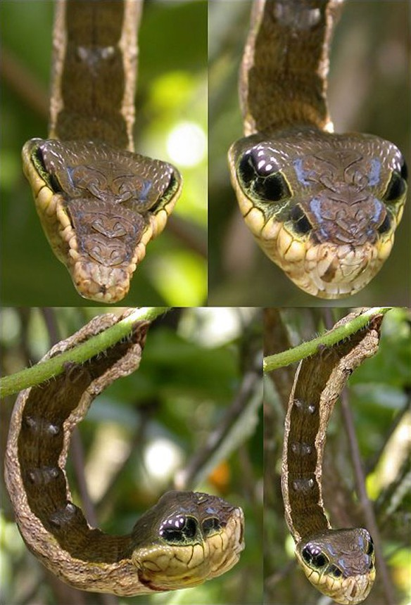
Mimicry
An adaptation where an animal or plant resembles another creature or inanimate object, either for defense or to gain other advantages.
This is really a caterpillar
Notes:
Instructional strategy – Present information in the slide. Ask students which animal the caterpillar is trying to mimic and why. Students will use this slide and the following two slides to fill in #13 on their notes sheet.

Slide 26
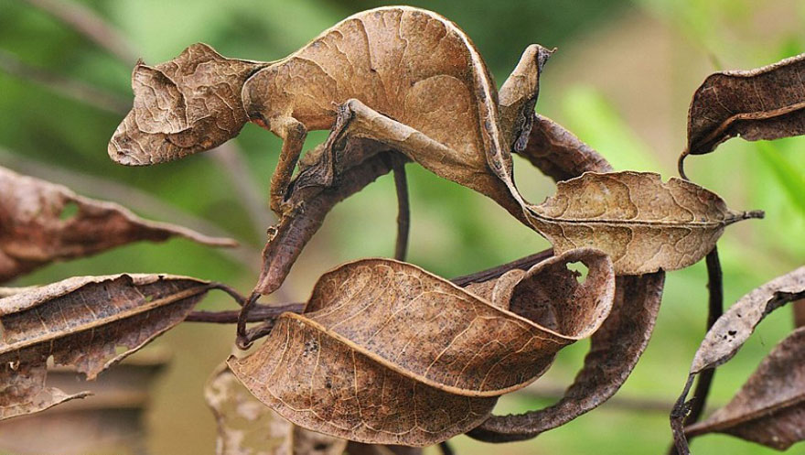
Where Am I?
Notes:
Instructional strategy – Activity linked in content map.

Slide 27
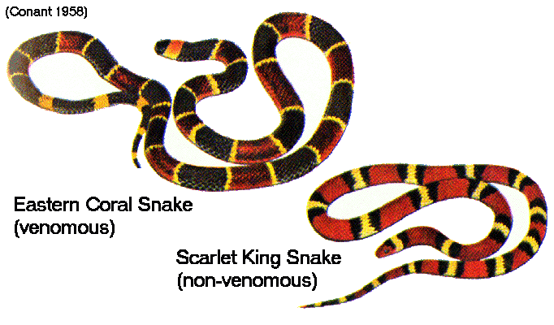
The King Snake resembles the Coral Snake so that predators will think it is poisonous.
Notes:
Instructional strategy – Present information in slide.

Slide 28
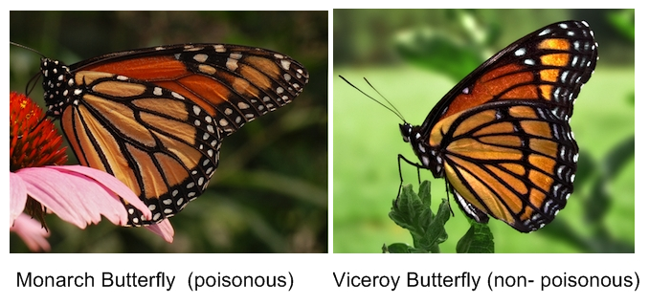
Which one is using Mimicry? How do you know?
Notes:
Instructional strategy – Viceroy butterfly is using mimicry to appear to be poisonous.

Slide 29
Organisms do not “decide” or make a decision to evolve. The process of natural selection allows for organisms with more desirable traits to survive, reproduce, and pass the desired traits to their offspring over successive generations.
Notes:
Instructional strategy – Present information on slide. Students will use the information to fill in #14 on their notes sheet.

Slide 30
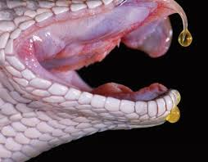
Over time, venom in snakes has evolved through natural selection to be more effective.
Notes:
Instructional strategy – Present information in the slide. Students will use this information to fill in #

Slide 31
The Stick Bug says study hard!! Bye

