Slide 1
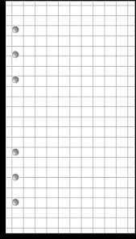
Pre-Calculus
Coach David Cagle
syllabus
Room: S215
Email: dcagle@cartersvilleschools.org
Phone: 770)382-3200
Required Materials
Calculator:
TI-36XPro
or
TI-84
Technology
3-Ring Binder
Pencils
Schoology will be used to post weekly agendas, class notes, handouts and various resources. Students can access this through the CHS homepage and login with their lunch number and birthday.
Grades
A+
Notebook Paper and Graph Paper
Expectations
Class Grade:
40% Formative Assessment
(daily work, homework, quizzes, etc.)
60% Summative Assessments
(tests, culminating tasks, projects, etc.)
Final Grade:
Class Grade: 90%
Final Exam: 10%
Follow the CANES CODE
Be ON TIME, Be PREPARED, Be RESPECTFUL and Be ON TASK.
Beginning of class → Take your seat by the time the bell rings, complete the bell-ringer, and wait for further instruction.
During class → Listen, participate, and ask questions!! Utilize your time wisely!
End of class → Stay in your seat until dismissed. Do NOT line up at the door.
*More information to come regarding free after school tutoring. Math tutoring will also be available during the first and second sessions on FAB Wednesdays.
*Remember you and only YOU are responsible for your choices and actions.
Consequences
Communication
Classroom Disruptions will be dealt with as follows:
1st Offense: Warning
2nd Offense: Teacher/Student Conference
3rd Offense: Parent Contact
4th Offense: Teacher Assigned Detention
*Any further offenses will result in an Administrative Referral
All parents and students are strongly encouraged to monitor student grades online in Infinite Campus. I will call, email and send information through the school’s messaging system, so it is essential that you make sure all contact information is up to date in our system. This can easily be done via our Cartersville City Schools Mobile App.

Slide 2
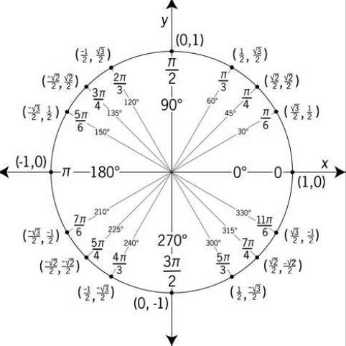
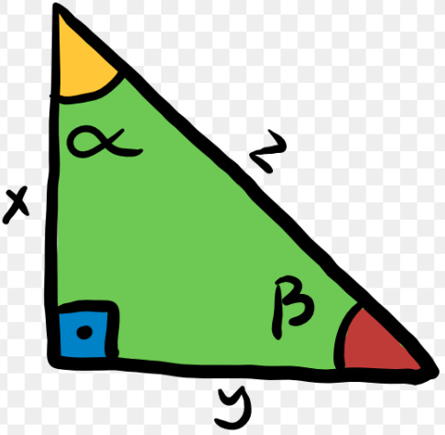
Pre-Calculus
Coach David Cagle
syllabus
Room: S215
Email: dcagle@cartersvilleschools.org
Phone: 770)382-3200
Course Description
Pre-Calculus is a fourth-year math option for students who have completed Advanced Algebra (or the equivalent). The course provides students with the opportunity to develop a deeper understanding of concepts in Algebra that are critical to the study of Calculus as well as an understanding of trigonometry and its applications. Throughout the course there should be a focus on notational fluency and the use of multiple representations.
Units of Study
.
Unit 1-Modeling with Rational and Piecewise-Defined Functions
Unit 2-Modeling with Trigonometric Expressions and Functions
Unit 3- Applying Trigonometric Identities and Equations
Unit 4- Modeling Conic Sections and Polar Equations
Unit 5- Modeling with Vector Quantities
Unit 6- Modeling with Sequences and Series
Unit 7-Culminating Capstone Unit
A full list of the standards can be found at georgiastandards.org
Classroom Policies
Students will bring their 3-ring binder, homework, paper, pencil and calculator to class EVERY day.
Students will have completed ALL assignments and be prepared to ask questions
If a student is absent, the assignment given on the last day present is due the day he or she returns to class. It is the student’s responsibility to promptly check with the teacher and on Schoology regarding make up work from an excused absence.
Late homework will not be accepted. Since math concepts often build on previously learned material, allowing late homework can be extremely counterproductive to student achievement.
Textbooks are available for students to check out at request. We will be using PreCalculus with Limits by Larson, and they cost $131 to replace.
The CHS Code of Conduct and the CHS attendance policy will be followed in this course.
Please keep this copy for your records. Please sign and return a completed Parent/Guardian Contact Information and Acknowledgment Form

Slide 3
Pre-Calculus Parent/Guardian Contact Information and Acknowledgment Form
Please sign below acknowledging that you have read and understand the information/expectations provided in the Syllabus for Pre-Calculus.
Student (printed) Name_______________________________________
Student Signature_______________________________Date_________
Parent (printed) Name________________________________________
Parent Signature________________________________ Date_________
Parent Cell Phone #___________________________________________
Parent E-mail Address_________________________________________
Notes/Questions/Concerns _____________________________________________________________________________________________________________________________________________________________________________________________________________________________________________________________________________________________________________________________________________________________________________________________________________________________

